Slide 1


Group 22

Slide 2
The system
This pharmacy system is a type of OTC(Over-The-Counter)system that allows any user to access the system through networking.
The user is the one that inputs all the data into the system.
The user begins to input the system logins that is the username and the access code …
The user then proceeds to choice window where the user can order medicine of choice and print receipt
The user can only access choice (1,2,3,4 and 6).Choice 5 is restricted to the pharmacy managers only.

Slide 3
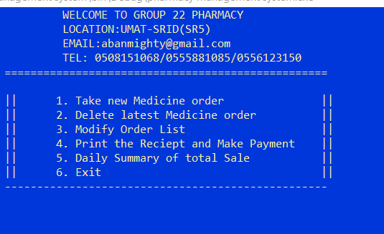
Console window

